Slide 1
Discrete Structures in Natural Language Processing (NLP)
CS131 Spring 2025 Semester Project
Justin Hudson
Notes:
Hello everyone! My name is Justin Hudson, and this is my CS 131 Semester Project. My presentation will be on the field of Natural Language Processing, or NLP. Specifically, we’ll look at how this increasingly vital discipline utilizes several of the discrete structures we have learned about throughout this semester.

Slide 2
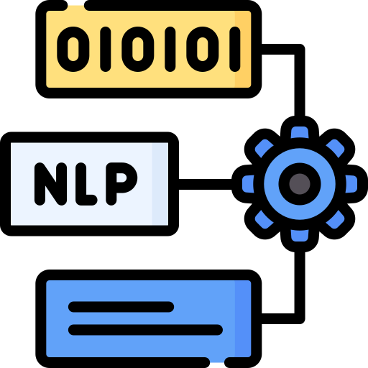
What is NLP?
Natural language processing (NLP) is the use of computer technology to assist in, or complete, tasks involving the processing, categorizing, analyzing, or interpreting the meaning of human language.
Notes:
But first off, what is natural language processing? Well, in brief, NLP is defined by the use of computer technology to assist in the processing, categorizing, analyzing, or interpreting of human language. As a multidisciplinary field, it stands at the nexus of computer science and linguistics and of course has major implications in the realms of artificial intelligence and machine learning. Despite how important the field has become in the modern world, its origins go back to the 1940s. Early attempts utilized a rule-based approach, where computers would be given explicit instructions on how to process language. However, the exceptions, rarities, and creativity that define human language make explicit rules extremely difficult to obtain. Thus, the field has shifted to statistics-based approaches, where accurate inferences about languages can be made with high probabilities, provided there is a sufficiently large corpus, or dataset of text, for a computer to make those inferences from.

Slide 3

Matrices
In Natural Language Processing (NLP), understanding the relationships between words is crucial for various applications, such as text analysis, information retrieval, and machine learning.
Notes:
With a large corpus in hand, one of the first tasks a computer needs to do to begin the task of language processing is to analyze the relationship between words, and matrices are a useful data structure to do so, as we learned in Chapter 2.6 of our textbook.

Slide 4
Document-Term Matrix
 | “royal” | “majesty” | “Rome” | “senate”
Richard III | 29 | 16 | 0 | 0
Julius Caeser | 2 | 0 | 26 | 7
Henry V | 11 | 36 | 1 | 0
Coriolanus | 2 | 0 | 80 | 14
Notes:
One of the simplest matrices to make to understand the relationship between words is a document-term matrix, or its transpose, a term-document matrix. Either one simply counts the number of times a word appears in each document in the corpus. To populate a document-term matrix, we loop over each document in our corpus and each time word j appears in document i, we add one to the i,j th element. In this example using the corpus of William Shakespeare, we see that the words “royal” and “majesty” often appear in the same documents, as do “Rome” and “senate”, suggesting those word pairs may be related.

Slide 5

Co-occurrence Matrix
Given a vocabulary of N unique words, a co-occurrence matrix C is an N x N matrix, where $C_{ij}$= the number of times word j appears in the context of word i
Notes:
A matrix that provides even more information on the relationship between words is known as a co-occurrence matrix, which captures the frequency with which pairs of words appear together within a specified context. It is a square matrix where rows and columns represent unique words in the corpus, and each element (i, j) contains the number of times word j appears in the context of word i. Let’s build a simple one to demonstrate:

Slide 6
Demo
Notes:
Here I have some code utilizing the Natural Language Toolkit (NLTK), an open source Python library for Natural Language Processing. One of the first things I’ll do is download a list of so-called “stop words”, very common words like “the” and “a”. Then, I will read a .txt file with these two sentences from our syllabus and textbook respectively. Using this very small corpus, I will build a set of all unique words in this file, as long as they contain alphanumeric characters and are not in the previously mentioned list of stop words. Next, an important step is to define our “context window”. A context window of size n would capture the n preceding and n subsequent words for each unique word in our corpus. With a context window of 1, only words directly adjacent to one another will be defined as co-occurring. From there, we make a count of how often each word appears adjacent to one another, then use that count to populate an N x N matrix, where N is the number of unique words in our corpus. Looking at our final cooccurrence matrix, we can note several features. Cooccurrence matrices are generally sparse matrices, meaning the value of most elements will be zero, since most words in any given corpus do not appear near each other. Further processing can be done to make this data more compact. Furthermore, these matrices are typically symmetrical, since, for example, the number of times “discrete” co-occurs with “mathematics” is going to be the same as the number of times “mathematics” co-occurs with “discrete”. Even with a corpus as small as this, we can infer that the word “discrete” has a stronger relationship to “mathematics” than it does to, say, “devoted”. However, one problem you may notice here is that our matrix has treated “mathematics” and “mathematical” as distinct words. This brings us to our next topic, stemming.

Slide 7
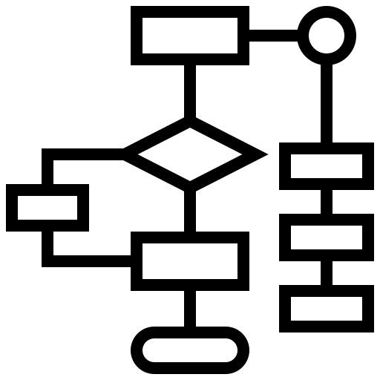
Algorithms
“Removing suffixes by automatic means is an operation which is especially useful in the field of information retrieval”.
-- Martin Porter, 1980
Notes:
As we learned in Chapter 3, an algorithm is a finite sequence of precise instructions for performing a computation or for solving a problem. The problem of categorizing variations of a word as the same root has been a major focus in the field of NLP for decades. The Porter stemming algorithm (or ‘Porter stemmer’) is a process for removing the more common morphological and inflexional endings from words in English. The original algorithm was written by Martin Porter in 1979 in the Computer Laboratory at the University of Cambridge, and is still in use 45 years later because of its relative simplicity and efficiency compared to other stemming algorithms.

Slide 8
Porter Stemmer Algorithm – Step 1
procedure porterStemmer(word: English word)
{Step 1a: remove plurals}
1. if word ends with “-sses” then replace with “-ss” {“caresses” -> “caress”}
2. else if word ends with “-ies” then replace with “-i” {“ponies” -> “poni”}
3. else if word ends in “-ss” then leave unchanged {“caress” -> “caress”}
4. else if word ends with “-s” then replace with “-s” {“cats” -> “cat”}
{Step 1b: remove –ed and –ing}
5. if word ends with “-eed” and VC sequences before “-eed” > 0 then replace with “-ee” {“agreed” -> “agree”, NOT “feed” -> “fee”}
6. else if word ends with “-ed” and vowels before “-ed” > 0 then
7. remove “-ed” {“plastered” -> “plaster”, NOT “bled” -> “bl”}
if word ends with “-at” or “bl” or “iz” then add “-e” {“conflat(ed)” -> “conflate”, “troubl(ed)” -> “trouble”}
else if word ends in double C not in (“l”, “s”, “z”) then remove last letter {“tann(ed)” -> “tan”, NOT “fizz(ed)” -> “fiz”}
else if VC sequences in word > 0 and word ends with CVC then add “-e” {“fil(ed)” -> “file”, NOT “fail(ed)” -> “faile”}
11. else if word ends with “-ing” and vowels before “-ing” > 0 then
12. remove “-ing” {“motoring” -> “motor”, NOT “sing” -> “s”}
13. perform lines 8-10
{Step 1c: change “-y” to “-I”}
14. if word ends with “-y” and vowels before “-y” > 0 then replace with “-i” {“happy” -> “happi”, NOT “why” -> “whi”}
Notes:
Let’s take a look at the first few steps of Porter’s algorithm, written in pseudocode. With an English word as its parameter, the algorithm first looks at the word’s final characters to determine if a plural suffix is present, and if so, removes it. Step 1b then looks to remove the common -ed and -ing suffixes. However, even this straightforward portion of the algorithm involves several nested conditional statements, and requires knowledge of the Vowel/Consonant structure of the input word so that it only removes the suffix on desired words.

Slide 9
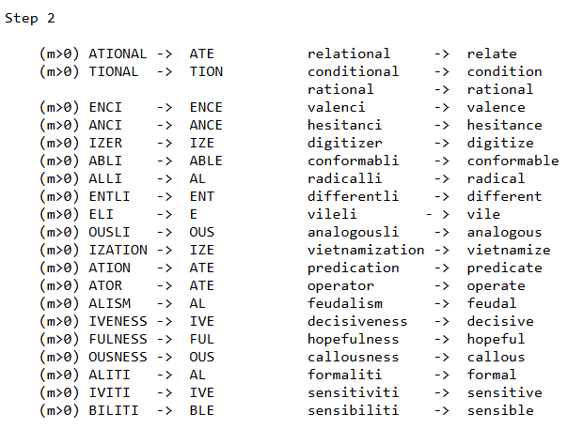
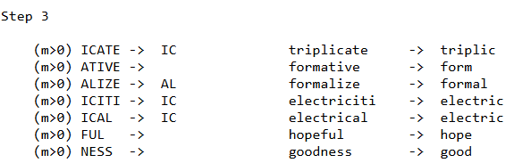
Porter Stemmer Algorithm – Additional Steps
Notes:
Steps 2-5 of the algorithm are summarized here, copied from Porter’s original paper. As you can see, once plural, -ed and -ing suffixes are removed…

Slide 10
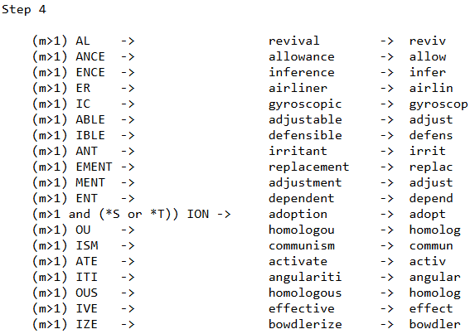
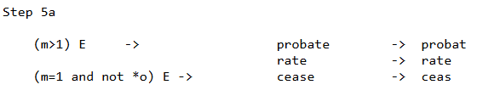
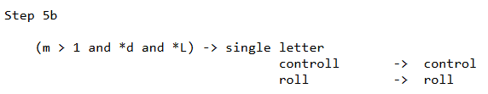
Porter Stemmer Algorithm – Additional Steps
Notes:
The algorithm handles a wide variety of other English suffixes, until it returns a stemmed form. Let’s see a quick demonstration:

Slide 11
Demo
Notes:
After doing similar preprocessing by finding the set of unique words in our corpus and removing stop words, I utilize the built-in Porter stemmer in NLTK, and print out a comparison of each word before and after it has been stemmed. As you can see, suffixes have been removed for many of the words. You may notice that the Porter stemmer does not necessarily return a valid English word. However, in many situations, it is only important that different forms of a word return the same stem. As we see hear, “mathematics” and “mathematical” would now be treated as the same stem in any future processing.

Slide 12


Bayes’ Theorem
$$p\left(F | E\right)=\frac{p\left(E | F\right)p(F)}{p(E)}$$
Notes:
Now that we have a way of accurately counting the words in our corpus, we can now perform text categorization, the task of assigning a label or category to an entire text or document. We can do so by utilizing a theorem we discovered in Chapter 7.3: Bayes’ Theorem. As discussed in the textbook, in addition to medicine, Bayes’ Theorem can be used to calculate the likelihood of an email being spam given it contains a certain word.

Slide 13

Sentiment Analysis
$$p\left(positive | "astonishing"\right)=\frac{p\left("astonishing" | positive\right)p(positive)}{p("astonishing")}$$
Notes:
In addition to spam filtering, another form of text classification that can use this theorem is sentiment analysis: classifying documents as positive or negative. For example, we can calculate the probability that a review is positive given it contains the words “astonishing” if we know the probability of a review being positive, the probability that a review contains the word “astonishing”, and the probability that a review contains the word “astonishing” given it is positive.

Slide 14
Demo
Notes:
To demonstrate, I have 200 movie reviews pulled from IMBD: 100 positive, and 100 negative. We do the same pre-processing of removing stop words and stemming. Then, we prompt the user for a word, and calculate how many times it appears in the positive reviews and the negative reviews. With that data, we can find each of the terms of Bayes’ Theorem and assign a probability to a review containing a given word. As one might imagine, a review with the word “astonishing” has a very high probability of being positive, while a review with the word “horrible” has a very low probability of being positive.

Slide 15
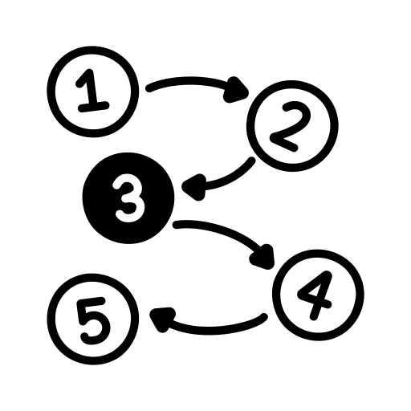
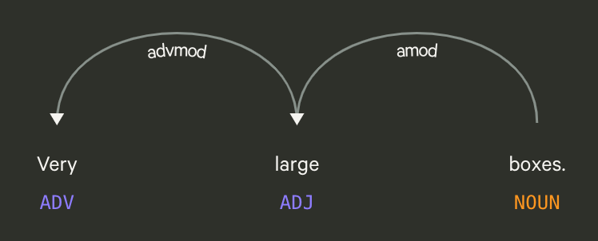
Graphs
Notes:
We are now able to connect words to a certain classification, and we previously determined the likelihood of two words being related. The last step in gaining a fuller understanding of human language is understanding how words are related to one another. Linguistics has long studied the grammatical relationships between words, and these relationships can be analyzed using yet another discrete structure we discussed in Chapter 10: graphs. Specifically, a knowledge graph is a graph of data intended to accumulate and convey knowledge of the real world, whose nodes represent entities of interest and whose edges represent relations between these entities. As a representation of semantic relations between entities, KGs have proven to be particularly relevant for natural language processing. Linguists have long noted the relationship between words/phrases (such as between an adjective and the noun it is describing) using directed links known as dependencies. Thus, graphs are a particularly well-suited structure for mapping semantics.

Slide 16
Demo
Notes:
For a demonstration, let’s look at a dataset that has already been parsed into subjects, verbs, and objects. (A variety of algorithms and datasets exist to assist in tagging and parsing unstructured text). We then create a directed multigraph, using the NetworkX Python package. For each 3-tuple of (subject, verb, object), we add nodes for each unique subject and object, and draw a directed edge from the subject to the object, labeling it with the verb that connects them. The final results allows to not only see that dogs, cats, and mice are related words, but to build an understanding of the nature of those relationships. For example, we see that dogs, cats, and mice are animals. We also see that dogs, cats, and mice drink water. If I added a node and directed edge to convey that “snakes” are “animals”, the existing data would allow a computer to reasonably infer that “snakes” drink “water”.

Slide 17
The End
Please keep this slide for attribution
Notes:
In conclusion, through structures like matrices, algorithms, discrete probability, and graphs, the chaotic, unpredictable world of human language can be categorized and interpreted by computers, enabling us to interact more easily with the technology of our everyday lives. Thank you.

Slide 18
Sources
https://methods.sagepub.com/foundations/natural-language-processing
https://surface.syr.edu/istpub/63/
https://mitpress.mit.edu/9780262133609/foundations-of-statistical-natural-language-processing/
https://www.mdpi.com/2076-3417/12/10/4859
Rosen et al., Discrete Mathematics and Its Applications
https://www.opensourceshakespeare.org/
https://www.geeksforgeeks.org/co-occurence-matrix-in-nlp/
https://web.stanford.edu/class/archive/cs/cs224n/cs224n.1194/assignments/a1_preview/exploring_word_vectors.html
https://cs224d.stanford.edu/lecture_notes/notes1.pdf
https://tartarus.org/martin/PorterStemmer/
https://www.nltk.org/_modules/nltk/stem/porter.html#PorterStemmer
https://www.kaggle.com/datasets/lakshmi25npathi/imdb-dataset-of-50k-movie-reviews?resource=download
https://web.stanford.edu/~jurafsky/slp3/4.pdf
https://languagelog.ldc.upenn.edu/nll/?p=48725
https://www.geeksforgeeks.org/build-a-knowledge-graph-in-nlp/
https://arxiv.org/abs/2210.00105

